Slide 1
Artificial Intelligence
Solving problems by searching

Slide 2
Problem solving
We want:
  To automatically solve a problem
We need:
  A representation of the problem
  Algorithms that use some strategy to solve the problem defined in that representation

Slide 3
Problem representation
General:
  State space: a problem is divided into a set of resolution steps from the initial state to the goal state
  Reduction to sub-problems: a problem is arranged into a hierarchy of sub-problems
Specific:
  Game resolution
  Constraints satisfaction

Slide 4
States
A problem is defined by its elements and their relations.
In each instant of the resolution of a problem, those elements have specific descriptors (How to select them?) and relations.
A state is a representation of those elements in a given moment.
Two special states are defined:
  Initial state (starting point)
  Final state (goal state)

Slide 5
State modification: successor function
A successor function is needed to move between different states.
A successor function is a description of possible actions, a set of operators. It is a transformation function on a state representation, which convert it into another state.
The successor function defines a relation of accessibility among states.
Representation of the successor function:
  Conditions of applicability
  Transformation function

Slide 6
State space
The state space is the set of all states reachable from the initial state.
It forms a graph (or map) in which the nodes are states and the arcs between nodes are actions.
A path in the state space is a sequence of states connected by a sequence of actions.
The solution of the problem is part of the map formed by the state space.

Slide 7
Problem solution
A solution in the state space is a path from the initial state to a goal state or, sometimes, just a goal state.
Path/solution cost: function that assigns a numeric cost to each path, the cost of applying the operators to the states
Solution quality is measured by the path cost function, and an optimal solution has the lowest path cost among all solutions.
Solutions: any, an optimal one, all. Cost is important depending on the problem and the type of solution sought.

Slide 8
Problem description
Components:
  State space (explicitly or implicitly defined)
  Initial state
  Goal state (or the conditions it has to fulfill)
  Available actions (operators to change state)
  Restrictions (e.g., cost)
  Elements of the domain which are relevant to the problem (e.g., incomplete knowledge of the starting point)
  Type of solution:
    Sequence of operators or goal state
    Any, an optimal one (cost definition needed), all

Slide 9
Example: 8-puzzle
1
2
3
4
5
6
7
8

Slide 10
Example: 8-puzzle
State space: configuration of the eight tiles on the board
Initial state: any configuration
Goal state: tiles in a specific order
Operators or actions: “blank moves”
  Condition: the move is within the board
  Transformation: blank moves Left, Right, Up, or Down
Solution: optimal sequence of operators

Slide 11
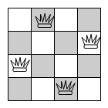
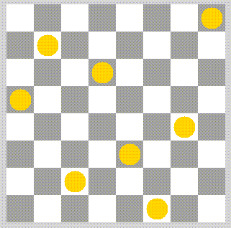
Example: n queens
(n = 4, n = 8)

Slide 12
Example: n queens
(n = 4, n = 8)
State space: configurations from 0 to n queens on the board with only one queen per row and column
Initial state: configuration without queens on the board
Goal state: configuration with n queens such that no queen attacks any other
Operators or actions: place a queen on the board
  Condition: the new queen is not attacked by any other already placed
  Transformation: place a new queen in a particular square of the board
Solution: one solution (cost is not considered)

Slide 13
Structure of the state space
Data structures:
  Trees: only one path to a given node
  Graphs: several paths to a given node
Operators: directed arcs between nodes
The search process explores the state space.
In the worst case all possible paths between the initial state and the goal state are explored.

Slide 14
Search as goal satisfaction
Satisfying a goal
  Agent knows what the goal is
  Agent cannot evaluate intermediate solutions (uninformed)
  The environment is:
    Static
    Observable
    Deterministic

Slide 15
Example: holiday in Romania
On holiday in Romania; currently in Arad
Flight leaves tomorrow from Bucharest at 13:00
Let’s configure this to be an AI problem

Slide 16
Romania
What’s the problem?
  Accomplish a goal
    Reach Bucharest by 13:00
So this is a goal-based problem

Slide 17
Romania
What’s an example of a non-goal-based problem?
  Live long and prosper
  Maximize the happiness of your trip to Romania
  Don’t get hurt too much

Slide 18
Romania
What qualifies as a solution?
  You can/cannot reach Bucharest by 13:00
  The actions one takes to travel from Arad to Bucharest along the shortest (in time) path

Slide 19
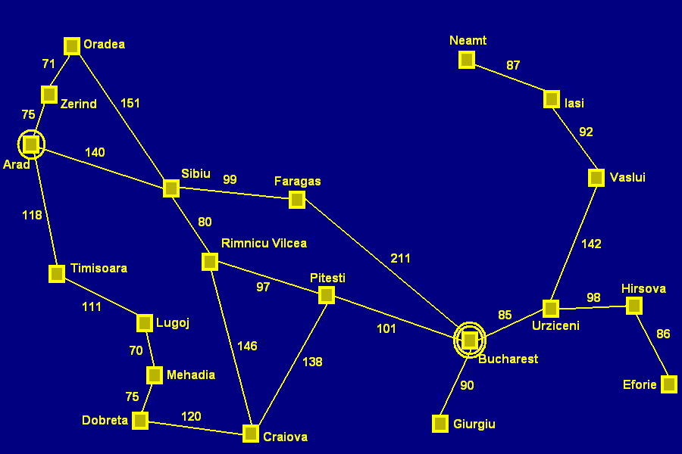
Romania
What additional information does one need?
  A map

Slide 20
More concrete problem definition
A state space
Which cities could you be in?
An initial state
Which city do you start from?
A goal state
Which city do you aim to reach?
A function defining state transitions
When in city foo, the following cities can be reached
A function defining the “cost” of a state sequence
How long does it take to travel through a city sequence?

Slide 21
More concrete problem definition
A state space
Choose a representation
An initial state
Choose an element from the representation
A goal state
Create goal_function(state) such that TRUE is returned upon reaching goal
A function defining state transitions
successor_function(state_{i}) =
{<action_{a}, state_{a}>, <action_{b}, state_{b}>, …}
A function defining the “cost” of a state sequence
cost (sequence) = number

Slide 22
Important notes about this example
  Static environment (available states, successor function, and cost functions don’t change)
  Observable (the agent knows where it is)
  Discrete (the actions are discrete)
  Deterministic (successor function is always the same)

Slide 23
Tree search algorithms
Basic idea:
  Simulated exploration of state space by generating successors of already explored states (AKA expanding states)
Sweep out from start (breadth)

Slide 24
Tree search algorithms
Basic idea:
  Simulated exploration of state space by generating successors of already explored states (AKA expanding states)
Go East, young man! (depth)

Slide 25
Implementation: general search algorithm
Algorithm General Search
Open_states.insert (Initial_state)
Current= Open_states.first()
while not is_final?(Current) and not Open_states.empty?() do
Open_states.delete_first()
Closed_states.insert(Current)
Successors= generate_successors(Current)
Successors= process_repeated(Successors, Closed_states, Open_states)
Open_states.insert(Successors)
Current= Open_states.first()
eWhile
eAlgorithm

Slide 26
Example: Arad → Bucharest
Algorithm General Search
Open_states.insert (Initial_state)
Arad

Slide 27
Example: Arad → Bucharest
Current= Open_states.first()
Arad

Slide 28
Example: Arad → Bucharest
while not is_final?(Current) and not Open_states.empty?() do
Open_states.delete_first()
Closed_states.insert(Current)
Successors= generate_successors(Current)
Successors= process_repeated(Successors, Closed_states, Open_states)
Open_states.insert(Successors)
Arad
Zerind (75)
Timisoara (118)
Sibiu (140)

Slide 29
Example: Arad → Bucharest
Current= Open_states.first()
Arad
Zerind (75)
Timisoara (118)
Sibiu (140)

Slide 30
Example: Arad → Bucharest
while not is_final?(Current) and not Open_states.empty?() do
Open_states.delete_first()
Closed_states.insert(Current)
Successors= generate_successors(Current)
Successors= process_repeated(Successors, Closed_states, Open_states)
Open_states.insert(Successors)
Arad
Zerind (75)
Timisoara (118)
Sibiu (140)
Dradea (151)
Faragas (99)
Rimnicu Vilcea (80)

Slide 31
Implementation: states vs. nodes
State
  (Representation of) a physical configuration
Node
  Data structure constituting part of a search tree
    Includes parent, children, depth, path cost g(x)
States do not have parents, children, depth, or path cost!

Slide 32
Search strategies
A strategy is defined by picking the order of node expansion
Strategies are evaluated along the following dimensions:
  Completeness – does it always find a solution if one exists?
  Time complexity – number of nodes generated/expanded
  Space complexity – maximum nodes in memory
  Optimality – does it always find a least-cost solution?

Slide 33
Search strategies
Time and space complexity are measured in terms of:
  b – maximum branching factor of the search tree (may be infinite)
  d – depth of the least-cost solution
  m – maximum depth of the state space (may be infinite)

Slide 34
Uninformed Search Strategies
Uninformed strategies use only the information available in the problem definition
  Breadth-first search
  Uniform-cost search
  Depth-first search
  Depth-limited search
  Iterative deepening search

Slide 35
Nodes
Open nodes:
  Generated, but not yet explored
  Explored, but not yet expanded
Closed nodes:
  Explored and expanded

Slide 36
Breadth-first search
Expand shallowest unexpanded node
Implementation:
  A FIFO queue, i.e., new successors go at end

Slide 37
Space cost of BFS
Because you must be able to generate the path upon finding the goal state, all visited nodes must be stored
O (b^{d+1})

Slide 38
Properties of breadth-first search
Complete?
  Yes (if b (max branch factor) is finite)
Time?
  1 + b + b² + … + b^{d} + b(b^{d}-1) = O(b^{d+1}), i.e., exponential in d
Space?
  O(b^{d+1}) (keeps every node in memory)
Optimal?
  Only if cost = 1 per step, otherwise not optimal in general
Space is the big problem; it can easily generate nodes at 10 MB/s, so 24 hrs = 860GB!

Slide 39
Depth-first search
Expand deepest unexpanded node
Implementation:
  A LIFO queue, i.e., a stack

Slide 40
Depth-first search
Complete?
    No: fails in infinite-depth spaces, spaces with loops.
    Can be modified to avoid repeated states along path ➔ complete in finite spaces
Time?
    O(b^{m}): terrible if m is much larger than d, but if solutions are dense, may be much faster than breadth-first
Space?
    O(bm), i.e., linear space!
Optimal?
    No

Slide 41
Depth-limited search
It is depth-first search with an imposed limit on the depth of exploration, to guarantee that the algorithm ends.

Slide 42
Treatment of repeated states
Breadth-first:
  If the repeated state is in the structure of closed or open nodes, the actual path has equal or greater depth than the repeated state and can be forgotten.

Slide 43
Treatment of repeated states
Depth-first:
  If the repeated state is in the structure of closed nodes, the actual path is kept if its depth is less than the repeated state.
  If the repeated state is in the structure of open nodes, the actual path has always greater depth than the repeated state and can be forgotten.

Slide 44
Iterative deepening search
The algorithm consists of iterative, depth-first searches, with a maximum depth that increases at each iteration. Maximum depth at the beginning is 1.
Behavior similar to BFS, but without the spatial complexity.
Only the actual path is kept in memory; nodes are regenerated at each iteration.
DFS problems related to infinite branches are avoided.
To guarantee that the algorithm ends if there is no solution, a general maximum depth of exploration can be defined.

Slide 45
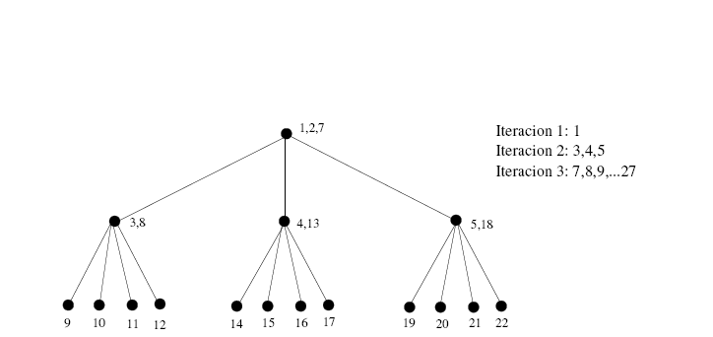
Iterative deepening search

Slide 46
Summary
  All uninformed searching techniques are more alike than different.
  Breadth-first has space issues, and possibly optimality issues.
  Depth-first has time and optimality issues, and possibly completeness issues.
  Depth-limited search has optimality and completeness issues.
  Iterative deepening is the best uninformed search we have explored.

Slide 47
Uninformed vs. informed
Blind (or uninformed) search algorithms:
  Solution cost is not taken into account.
Heuristic (or informed) search algorithms:
  A solution cost estimation is used to guide the search.
  The optimal solution, or even a solution, are not guaranteed.

